Slide 1
Building Java Programs Chapter 18
Advanced Data Structures: Hashing and Heaps

Slide 2
Priority Queues and Heaps
Reading: 18.2

Slide 3
Question
Who should get into the movies first?
The first person in line?
The last person in line?
The richest person?
The best looking person?
Who should get into the Emergency Room First?
The first person in line?
The last person in line?
The person with the cold?
The person with the gunshot wound?
The person currently having a heart attack?

Slide 4
Prioritization problems
print jobs: lab printers constantly accept and complete jobs from all over the building. We want to print faculty jobs before staff before student jobs, and grad students before undergrad, etc.
ER scheduling: Scheduling patients for treatment in the ER. A gunshot victim should be treated sooner than a guy with a cold, regardless of arrival time. How do we always choose the most urgent case when new patients continue to arrive?
key operations we want:
add an element (print job, patient, etc.)
get/remove the most "important" or "urgent" element

Slide 5
Priority Queue ADT
priority queue: A collection of ordered elements that provides fast access to the minimum (or maximum) element.
add adds in order
peek returns minimum or "highest priority" value
remove removes/returns minimum value
isEmpty, clear, size, iterator
pq.add("if"); pq.add("from"); ...
"the"
"of"
"if"
"to"
"down"
"from"
pq.remove()
"by"
"she"
"by"
"in"
"you"
"why"
"him"
priority queue

Slide 6
So how do we implement it?
Priority Queue

Slide 7
Unfilled array?
Consider using an unfilled array to implement a priority queue.
add: Store it in the next available index, as in a list.
peek: Loop over elements to find minimum element.
remove: Loop over elements to find min. Shift to remove.
queue.add(9); queue.add(23); queue.add(8); queue.add(-3); queue.add(49); queue.add(12); queue.remove();
How efficient is add? peek? remove?
O(1), O(N), O(N)
(peek must loop over the array; remove must shift elements)
index | 0 | 1 | 2 | 3 | 4 | 5 | 6 | 7 | 8 | 9
value | 9 | 23 | 8 | -3 | 49 | 12 | 0 | 0 | 0 | 0
size | 6

Slide 8
Sorted array?
Consider using a sorted array to implement a priority queue.
add: Store it in the proper index to maintain sorted order.
peek: Minimum element is in index [0].
remove: Shift elements to remove min from index [0].
queue.add(9); queue.add(23); queue.add(8); queue.add(-3); queue.add(49); queue.add(12); queue.remove();
How efficient is add? peek? remove?
O(N), O(1), O(N)
(add and remove must shift elements)
index | 0 | 1 | 2 | 3 | 4 | 5 | 6 | 7 | 8 | 9
value | -3 | 8 | 9 | 12 | 23 | 49 | 0 | 0 | 0 | 0
size | 6

Slide 9
Linked list?
Consider using a doubly linked list to implement a priority queue.
add: Store it at the end of the linked list.
peek: Loop over elements to find minimum element.
remove: Loop over elements to find min. Unlink to remove.
queue.add(9); queue.add(23); queue.add(8); queue.add(-3); queue.add(49); queue.add(12); queue.remove();
How efficient is add? peek? remove?
O(1), O(N), O(N)
(peek and remove must loop over the linked list)
9
23
8
-3
49
12
front
back

Slide 10
Sorted linked list?
Consider using a sorted linked list to implement a priority queue.
add: Store it in the proper place to maintain sorted order.
peek: Minimum element is at the front.
remove: Unlink front element to remove.
queue.add(9); queue.add(23); queue.add(8); queue.add(-3); queue.add(49); queue.add(12); queue.remove();
How efficient is add? peek? remove?
O(N), O(1), O(1)
(add must loop over the linked list to find the proper insertion point)
-3
8
9
12
23
49
front
back

Slide 11
Binary search tree?
Consider using a binary search tree to implement a PQ.
add: Store it in the proper BST L/R - ordered spot.
peek: Minimum element is at the far left edge of the tree.
remove: Unlink far left element to remove.
queue.add(9); queue.add(23); queue.add(8); queue.add(-3); queue.add(49); queue.add(12); queue.remove();
How efficient is add? peek? remove?
O(log N), O(log N), O(log N)...?
(good in theory, but the tree tends to become unbalanced to the right)
9
8
23
-3
12
49

Slide 12
Unbalanced binary tree
12
queue.add(9); queue.add(23); queue.add(8); queue.add(-3); queue.add(49); queue.add(12); queue.remove(); queue.add(16); queue.add(34); queue.remove(); queue.remove(); queue.add(42); queue.add(45); queue.remove();
Simulate these operations. What is the tree's shape?
A tree that is unbalanced has a height close to N rather than log N, which breaks the expected runtime of many operations.
23
16
49
34
42
45

Slide 13
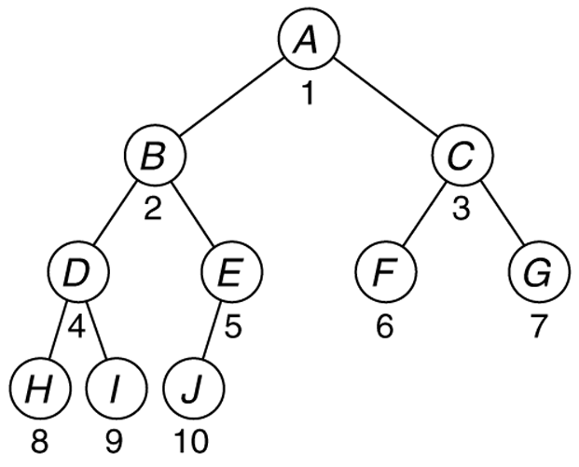
Heaps
heap: A complete binary tree with vertical ordering.
complete tree: Every level is full except possibly the lowest level, which must be filled from left to right
(i.e., a node may not have any children until all possible siblings exist)

Slide 14
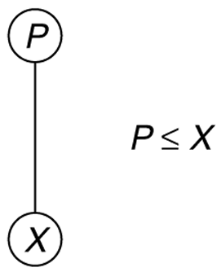
Heap ordering
heap ordering: If P ≤ X for every element X with parent P.
Parents' values are always smaller than those of their children.
Implies that minimum element is always the root (a "min-heap").
variation: "max-heap" stores largest element at root, reverses ordering
Is a heap a BST? How are they related?

Slide 15
Which are min-heaps?
no
10
no
no
20
10
20
80
10
80
20
80
40
60
85
99
40
60
85
99
30
15
50
700
50
700
10
no
20
80
10
10
40
60
85
99
20
80
20
80
50
700
40
60
99
40
60

Slide 16
Heap height and runtime
The height of a complete tree is always log N.
How do we know this for sure?
Because of this, if we implement a priority queue using a heap, we can provide the following runtime guarantees:
add: O(log N)
peek: O(1)
remove: O(log N)
n-node complete tree
of height h:
2^{h} ≤ n ≤ 2^{h+1} – 1
h = ⎣log n⎦

Slide 17
The add operation
When an element is added to a heap, where should it go?
Must insert a new node while maintaining heap properties.
queue.add(15);
new node
10
15
20
80
40
60
85
99
50
700
65

Slide 18
The add operation
When an element is added to a heap, it should be initially placed as the rightmost leaf (to maintain the completeness property).
But the heap ordering property becomes broken!
10
10
20
80
20
80
40
60
85
99
40
60
85
99
50
700
65
50
700
65
15

Slide 19
"Bubbling up" a node
bubble up: To restore heap ordering, the newly added element is shifted ("bubbled") up the tree until it reaches its proper place.
Weiss: "percolate up" by swapping with its parent
How many bubble-ups are necessary, at most?
10
10
20
80
15
80
40
60
85
99
40
20
85
99
50
700
65
15
50
700
65
60

Slide 20
Bubble-up exercise
Draw the tree state of a min-heap after adding these elements:
6, 50, 11, 25, 42, 20, 104, 76, 19, 55, 88, 2
2
19
6
25
42
11
104
76
50
55
88
20

Slide 21
The peek operation
A peek on a min-heap is trivial to perform.
because of heap properties, minimum element is always the root
O(1) runtime
Peek on a max-heap would be O(1) as well (return max, not min)
10
20
80
40
60
85
99
50
76
65

Slide 22
The remove operation
When an element is removed from a heap, what should we do?
The root is the node to remove. How do we alter the tree?
queue.remove();
10
20
80
40
60
85
99
50
700
65

Slide 23
The remove operation
When the root is removed from a heap, it should be initially replaced by the rightmost leaf (to maintain completeness).
But the heap ordering property becomes broken!
10
65
20
80
20
80
40
60
85
99
40
60
85
99
700
50
65
700
50
65

Slide 24
"Bubbling down" a node
bubble down: To restore heap ordering, the new improper root is shifted ("bubbled") down the tree until it reaches its proper place.
Weiss: "percolate down" by swapping with its smaller child (why?)
How many bubble-down are necessary, at most?
65
20
20
80
40
80
40
60
85
99
50
60
85
99
74
50
74
65

Slide 25
Bubble-down exercise
Suppose we have the min-heap shown below.
Show the state of the heap tree after remove has been called 3 times, and which elements are returned by the removal.
2
19
6
25
42
11
104
76
50
55
88
20

